Slide 1



Payment Methods in E-Commerce
GROUP 1
Aastha Joshi
Harsh Tambe
Joel Keith Pais
P. Vignesh
Taksande Sandeep Ravindra
20020845001
20020845010
20020845011
20020845020
20020845030

Slide 2

Payment Regulations
What is a payment gateway?
CONTENTS
What is a payment processor?
Transaction cost in payments
Scope of analytics in payments

Slide 3

Payment Regulations
Regulatory Bodies
Department Industrial Policy and Promotion - FDI in E-Commerce
Ministry of Electronics and Information technology (MeitY)/ Ministry of Communications - promoting the internet, IT and e-commerce
Computer Emergency Response Team - responds to cybersecurity incidents
Reserve Bank of India - regulates payment systems and online e-commerce transactions
Statutes Governing Establishment of Digital Business
IT Act
Payment and Settlement Act 2007
Foreign Exchange Management Act 1999
Trademarks Act 1999
Provides a legal framework for electronic governance
Defines cyber crimes and prescribes penalties
Penalized sending "offensive messages"
To carry out financial transactions in the country
To provide regulation and supervision of payment methods in India.
To consolidate and amend the law relating to foreign exchange.
Gives the central government the power to impose the restrictions
Deals in foreign exchange
Deals with the mechanism of registration,
Protection of trademark and prevention of fraudulent trademark, 3D marks are made registrable; e-filing is promoted

Slide 4
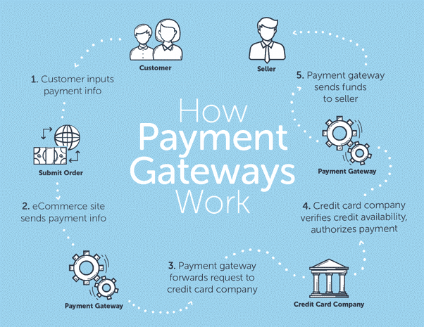
What is a payment gateway?
A payment gateway is a merchant service that processes credit card payments for ecommerce sites and traditional brick and mortar stores. Popular payment gateways include PayPal/Braintree, Stripe, Square etc.
Payment gateways accomplish both secure and convenient transactions in a few seconds with these steps:
Encryption: Between the user’s browser and the server of the retailer, a payment gateway will encrypt (encode for private use) data for exclusive use between seller and buyer.
Request: The authorization request occurs when a payment processor gets approval from a credit card company or financial institution to proceed with the transaction.
Fulfillment: When the payment gateway has the authorization, it allows the website and interface to proceed to the next action. The payment gateway also serves a few other functions including screening orders, calculating tax costs, and using geolocation for location-specific actions.

Slide 5

What is a payment processor?
Payment processors act as intermediaries between businesses and financial institutions, enabling both e-commerce and brick-and-mortar businesses to accept various payment methods. Some examples are PayPal, RazorPay etc.
At a basic level, payment processors evaluate a transaction’s validity in real-time by contacting the customer’s issuing bank.
How a payment processor works?
A shopper chooses an item to purchase from a merchant, whether in-person or online.
At check out, the shopper might swipe a card, scan a mobile device, or manually enter payment information at the POS or online payment gateway.
If approved, the acquiring bank settles the transaction. Finally, the payment processor ensures the funds are transmitted into the merchant’s account.
The shopper’s payment information is then transmitted to the payment processor, which then evaluates the transaction’s validity by communicating with both the issuing and acquiring banks

Slide 6
Transaction cost in payments
Transaction Fees is a type of a fee when the client needs to pay every moment it processes an electronic payment. Transaction Fees can vary among the services. On average, the fee is a proportion of the amount of the transfers fulfilled.
Three pillars of the market.
1. A merchant: The person who sells products/services online.
2. A payment system provider (PSP): The company that provides a merchant with software that allows accepting online payments.
3. A payment gateway: The software itself. It processes the transactions made on a merchant’s website.
The fees merchants pay will include:
• The interchange fee that goes to the issuing bank,
• The network fee that goes directly to Visa or Mastercard,
• The acquirer fee that goes to acquiring the bank
To accept payment online a merchant needs a payment gateway. He thus signs a contract with a PSP.
The contract states that a fixed percentage out of each transaction will be charged on behalf of a PSP.

Slide 7
Scope of analytics in payments
Can provide insight into where your customers are located and how you are reaching out to them
Can help reconcile data from multiple accounts in multiple currencies
Can determine which payment methods work best for which customers
Can improve the security of online payments
Decrease Chargebacks

Slide 8
References
https://www.lexology.com/library/detail.aspx?g=f45d85e6-6618-4b80-a434-61c206a7ac11
https://blog.ipleaders.in/payment-settlement-system-act-2007/
https://en.wikipedia.org/wiki/Information_Technology_Act,_2000
https://en.wikipedia.org/wiki/Foreign_Exchange_Management_Act
https://byjus.com/free-ias-prep/indian-companies-act/
https://www.americanexpress.com/us/foreign-exchange/articles/what-is-a-payment-processor-and-how-it-works/
https://en.wikipedia.org/wiki/Indian_trademark_law
https://www.talend.com/resources/big-data-ecommerce
https://home.bluesnap.com/snap-center/blog/ecommerce-payment-analytics/
https://ikajo.com/glossary/transaction-fees

